Slide 1
Gastrointestinal Disorders
Dr. Divya Gupta
BHMS, MD (Hom.)
Assistant Professor
Department of Pathology

Slide 2
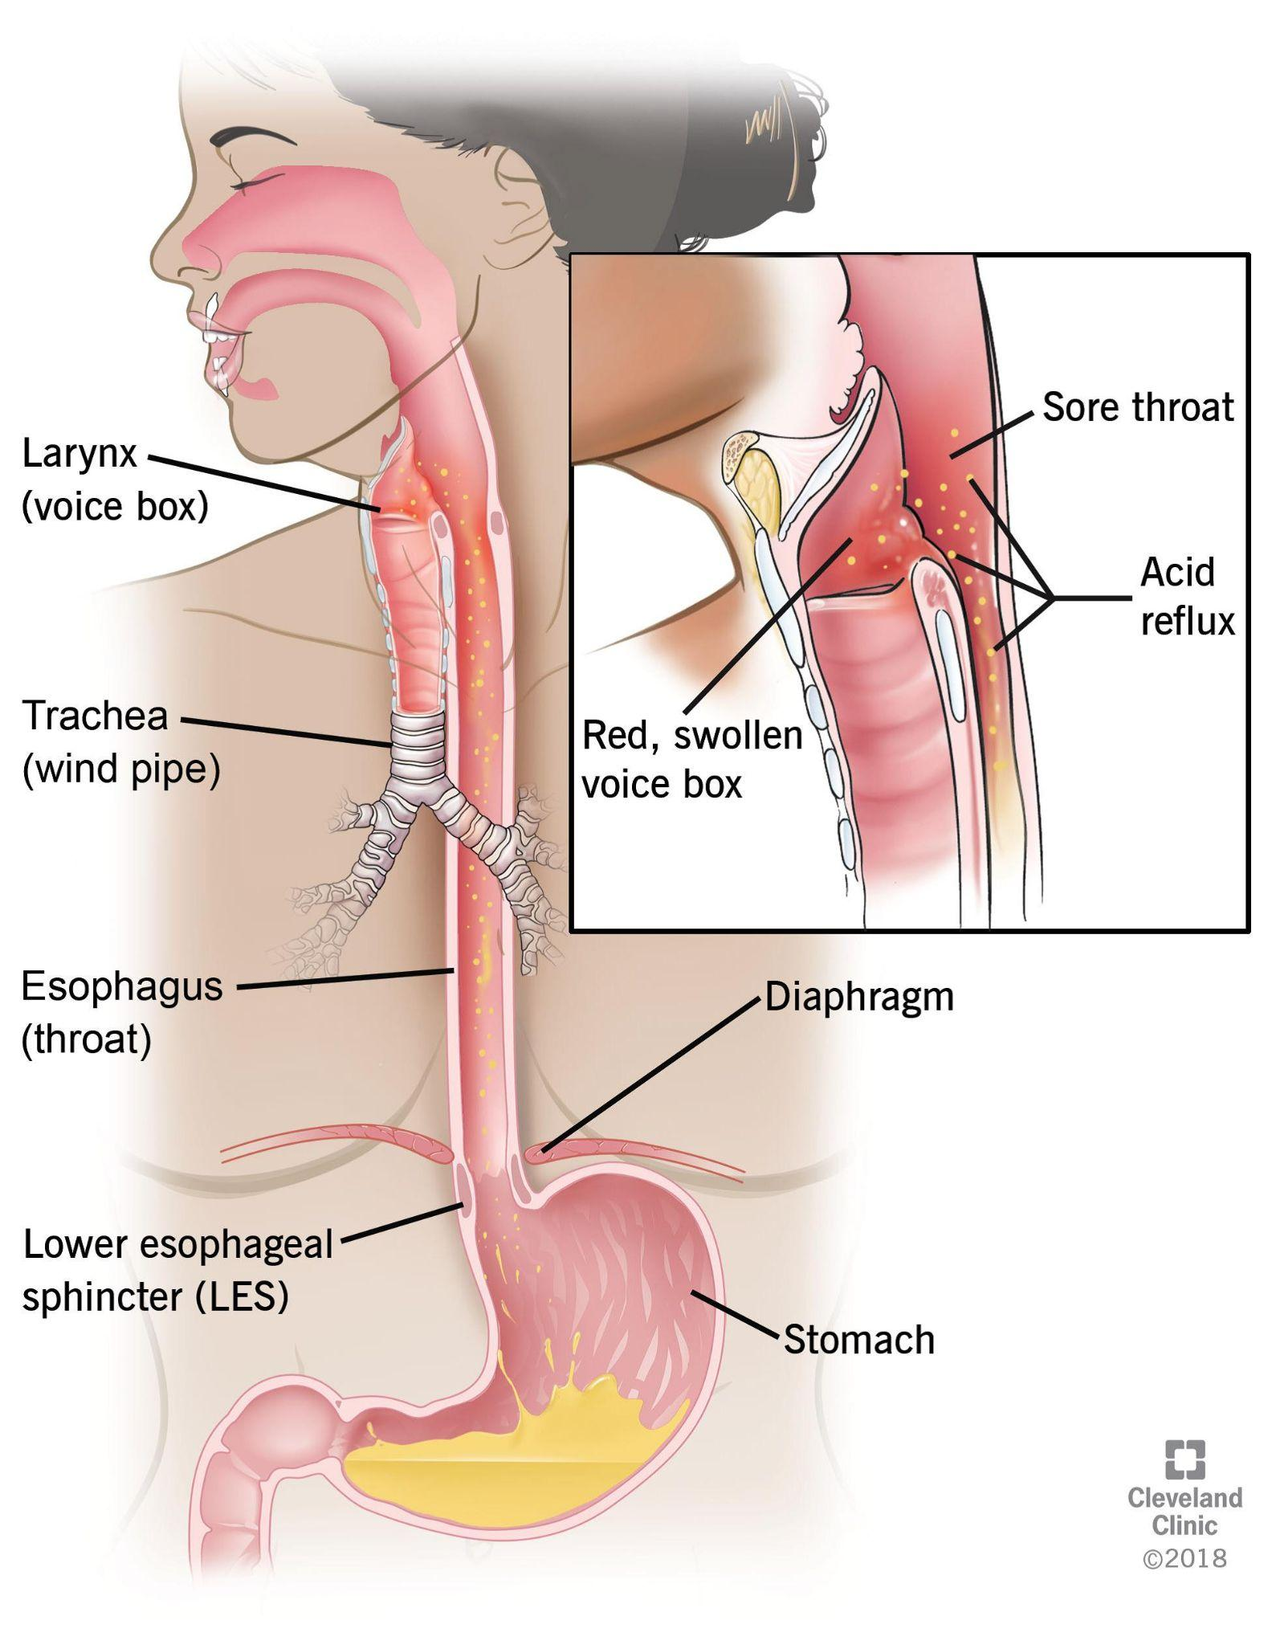
Disorders of
Oesophagus

Slide 3
Congenital Abnormalities
Types
Stenosis
Atresia
Fistula
Newborn aspirates while feeding.
Pneumonia

Slide 4
Not an easy repair

Slide 5
Achalasia
Lack of relaxation of cardiac sphincter
The default condition is contraction
Inflammation leads to
Scarring and
Loss of ganglia cells
Decreased innervation means no relaxation
Leads to retention of food, inflammation and more scarring

Slide 6
Esophageal Scarring and Ring formation
Inflammation leads to
Scarring and
Loss of ganglia cells
Decreased innervation means no relaxation
Leads to retention of food, inflammation and more scarring

Slide 7
Esophageal Diverticulae
Traction
Pulsion
Magicians

Slide 8
Hiatal Hernia
Incompetence of diaphragmatic opening
Portion of stomach is in thorax
‘Sliding’ type ->
Leads to
Regurgitation of food
Acid reflux
Ulceration

Slide 9
Hiatal Hernia
“Rolling type
May lead to gastric mucosal ischemia.
Ulceration
GI bleeding

Slide 10
Esophagitis
Inflammation of mucosa
Lots of causes
Reflux of stomach acid ->
Infectious agents
Bacteria
Viral (HIV)
Fungal (HIV)
Cytotoxic agents
Autoimmune

Slide 11
Barrett’s Change
Metaplasia of squamous epithelium
Columnar epi
Repeat injury
Reflux
Indicates serious or prolonged damage
Cancer risk?

Slide 12
Barrett’s Change

Slide 13
Esophageal Varices
Dilation of esophageal veins, distal 1/3.
Increased venous portal pressure.
Cirrhosis
Life threatening hemorrhage

Slide 14
Esophageal Varices

Slide 15
Esophageal Varices

Slide 16
Esophageal Cancer
Squamous cell
Repeat irritation
Tobacco
Invasive
Barrett’s change
Adenocarcinoma

Slide 17
Esophageal Cancer

Slide 18
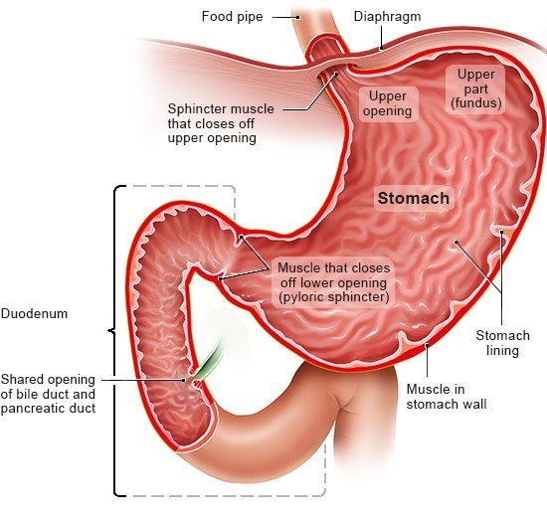
Disorders of the Stomach

Slide 19
Gastritis
Acute
Polys
ETOH
H. pylori
Pain
Bleeding
Chronic
Mucosal atrophy
Mucin cell hyper
Lymphocytes
Autoimmune
B-12 deficiency

Slide 20
Chronic Gastritis

Slide 21
Helicobacter pylori
Gram negative rod
Lives on the epithelial surface.
Urease destroys mucus
Increases acid secretion
Reduces duodenal bicarb
Intensifies inflammatory response
Immunogenic

Slide 22
Peptic Ulcer
Action of digestion
Balance between good and evil
H. pylori
NSAIDs
Aspirin
Complications
Bleeding
Perforation
Penetration
Scarring
Zollinger-Ellison
Gastrin secreting tumor

Slide 23
Good and Evil

Slide 24
Stress Ulcers
This means stress, not surprise (pop quiz)
Trauma
Major
Head injury
Burns
Vascular mediated
Rearranged blood flow
Multiple ‘erosions’
Confined to mucosa
Can bleed seriously

Slide 25
Gastric Cancer
Adenocarcinoma
Risk factors
Nitrites
Smoked foods
Chronic gastritis with H. pylori

Slide 26
Linitis Plastica

Slide 27
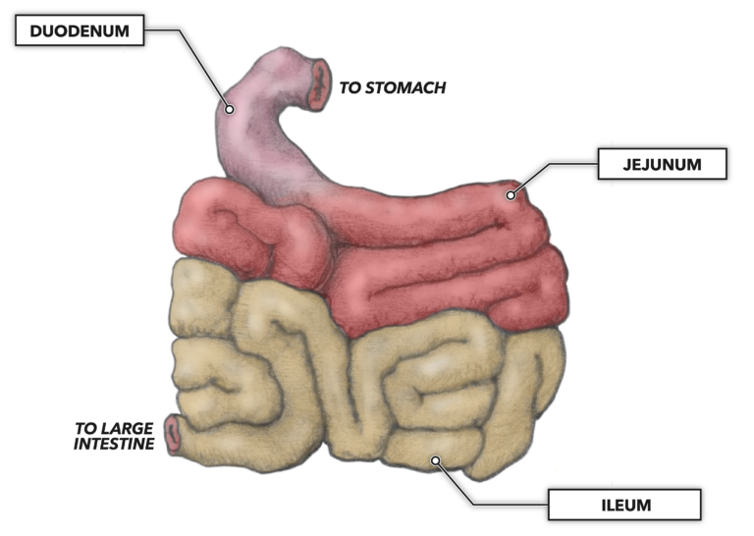
Small Bowel Disease

Slide 28
Mechanical Problems

Slide 29
Intussesception

Slide 30
Meckle’s Diverticulum
Congenital diverticulum of the distal small bowel.
2 kinds of mucosa
2 feet from the ileocecal valve.
2 inches in size.
Twice as common in males

Slide 31
Problems with a Meckle’s

Slide 32
Vascular Related
Bowel infarction
Hemorrhagic
Venous
Arterial
Septic shock
Very painful

Slide 33
Bowel infarction

Slide 34
Infectious Enteritis
Many agents infect the small bowel.
Viral
Bacteria
Salmonella
Parasites
Unicellular
Giardia
Multicellular
Worms

Slide 35
Non-infectious Inflammatory
Crohn’s disease
Granulmatous enteritis
Transmural inflammation
No known infectious agent
Granulomas in about 40%
Fistula formation
Relapsing
Small bowel or colon
Ethnicity
No significant increased risk of cancer (minimal at best)

Slide 36
Crohn’s Disease
Transmural inflammation
Scarring and stricture formation
Fistulae

Slide 37
Crohn’s Microscopic
Granulomas about 40% of the time.
Transmural all the time

Slide 38
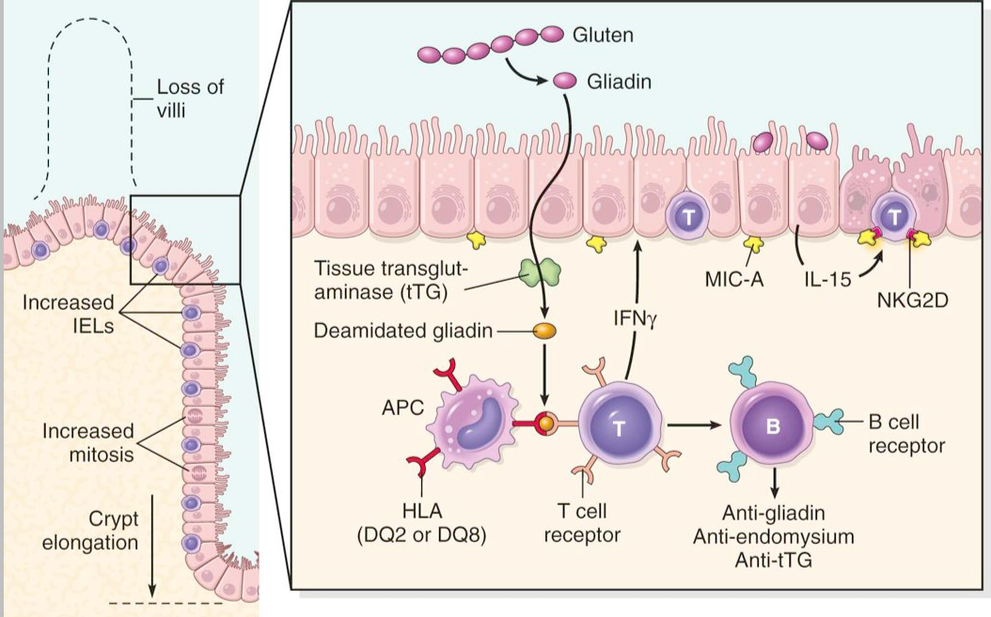
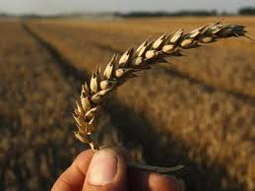
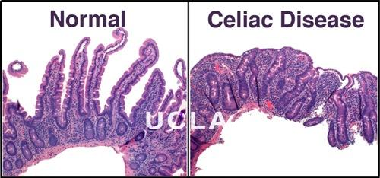
Gluten Enteropathy

Slide 39
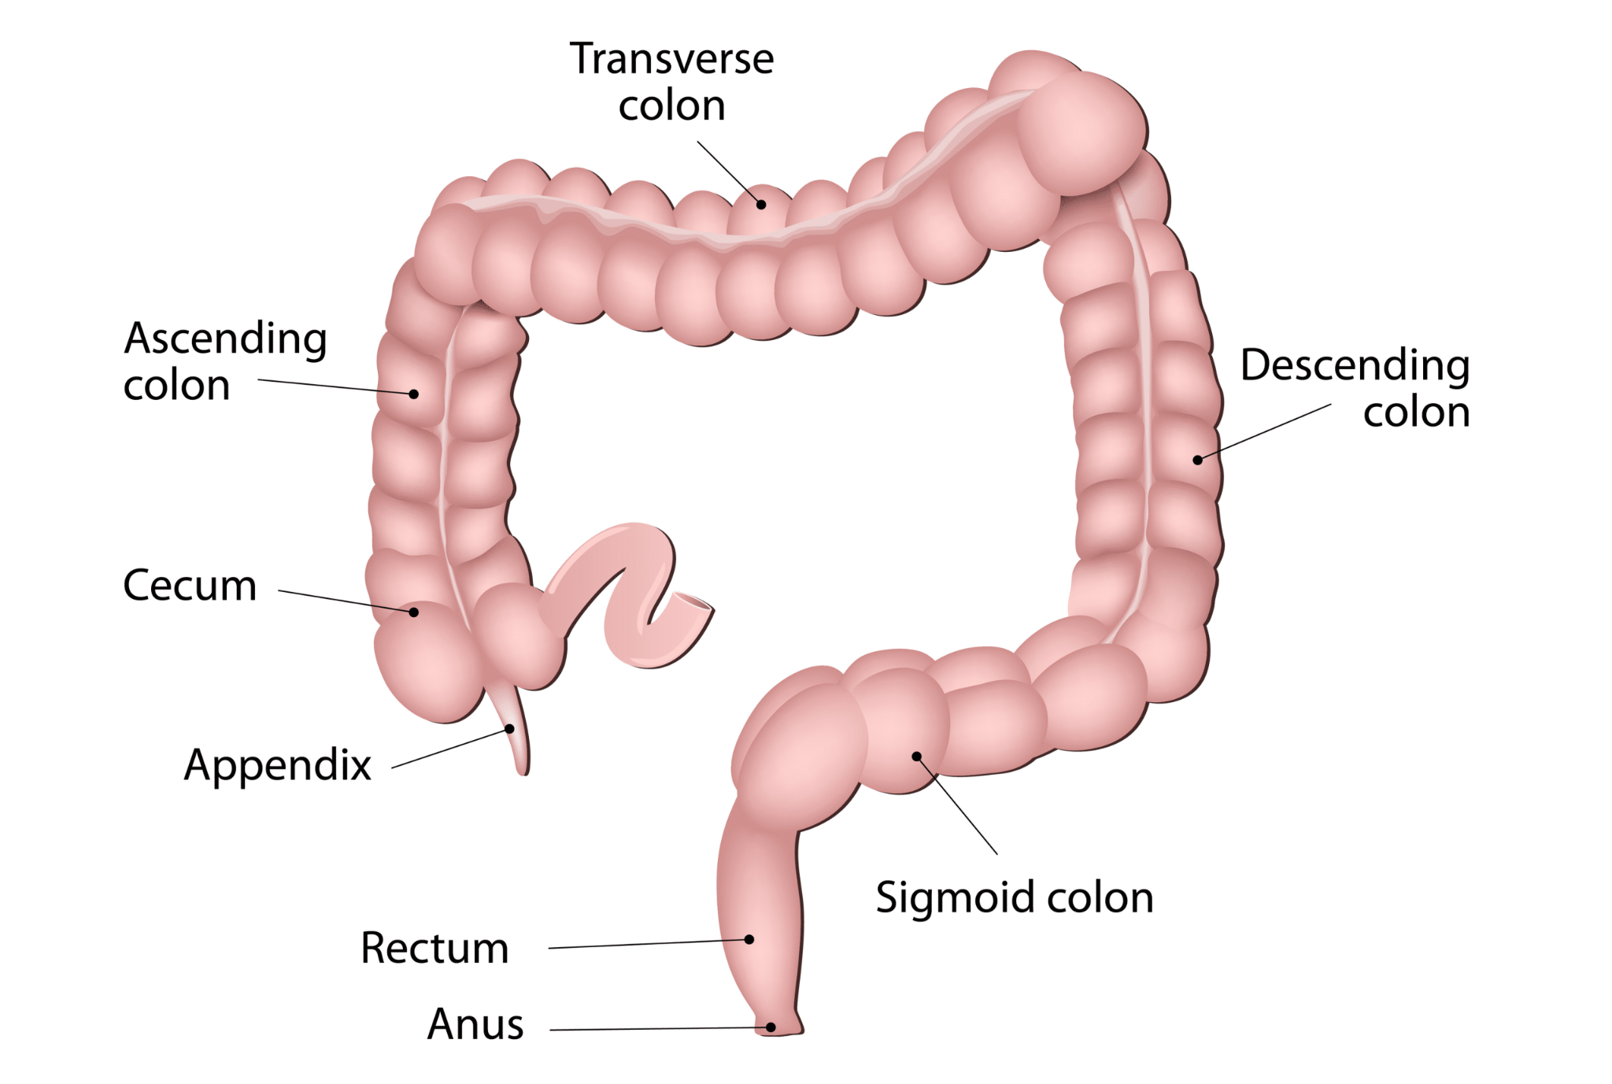
Colonic Disease

Slide 40
Hirschprung’s Disease
Aganglionic segment
Peristalsis stops
Dilation of colon back stream of the defective segment.
Remove distal portion that looks healthy.
Look for ganglia.

Slide 41
Ulcerative Colitis
Mucosal
Crypt abscesses
Autoimmune element?
Starts in rectum and works its way back.
Pseudopolyps
Toxic megacolon
Increased cancer risk

Slide 42
Ulcerative Colitis

Slide 43
Crypt Abscess

Slide 44
Diverticulosis

Slide 45
Diverticulitis

Slide 46
Colonic Polyps

Slide 47
Colonic Polyps

Slide 48
Familial Polyposis
Millions of adenomatous polyps
Genetic predisposition
100% of chance of cancer

Slide 49
Familial Polyposis

Slide 50
Familial Polyposis

Slide 51
Colon Cancer
Right and left side have different presentations
Right = anemia
Left = bowel changes
Contributing factors
Genetics
Dietary fiber
Dietary fat
Spread
Liver
Lymph nodes

Slide 52
Genetics of Colon Cancer

Slide 53
Colon Cancer

Slide 54
Appendicitis

Slide 55
Appendicitis
Obstruction of mouth of appendix
Fecolith
Enlarged lymph nodes
Bacteria proliferate and invade wall.
Rupture
Peritonitis
Abscess

Slide 56
Inguinal Hernia

Slide 57
Direct Abdominal Hernia

Slide 58
Thank You

