Slide 1
Dr. Devendra Muzalda
(Professor)
Faculty Of Humanities and Social Sciences
Madhav University, Pindwada (Sirohi)

Slide 2
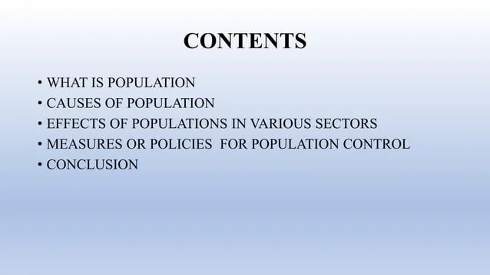

Slide 3
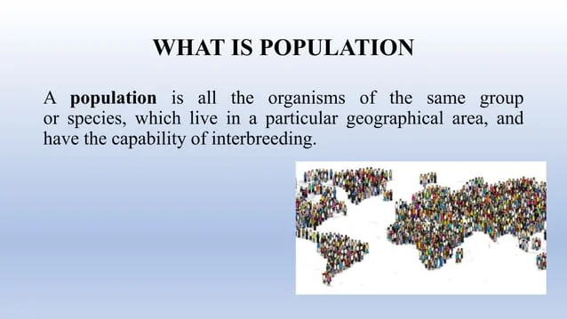

Slide 4
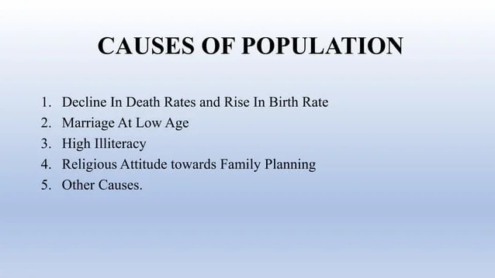

Slide 5


Slide 6


Slide 7


Slide 8


Slide 9
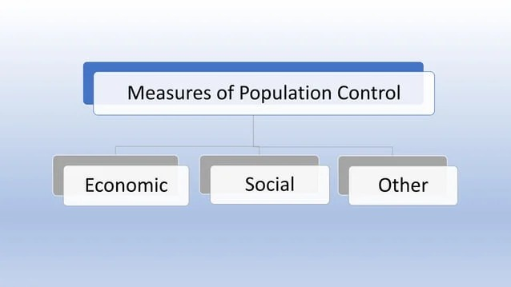

Slide 10


Slide 11
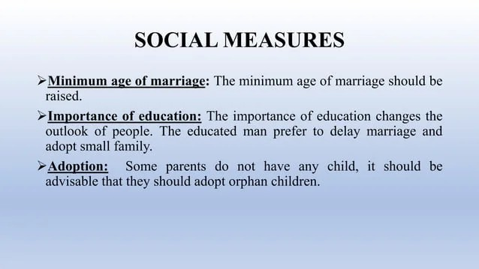

Slide 12
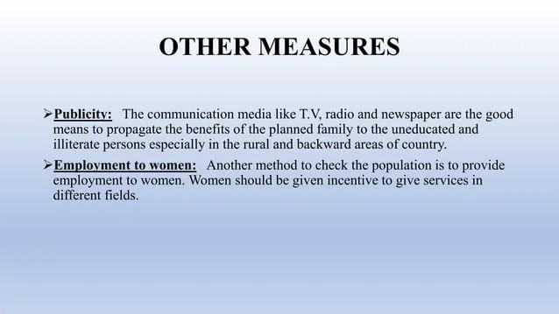

Slide 13
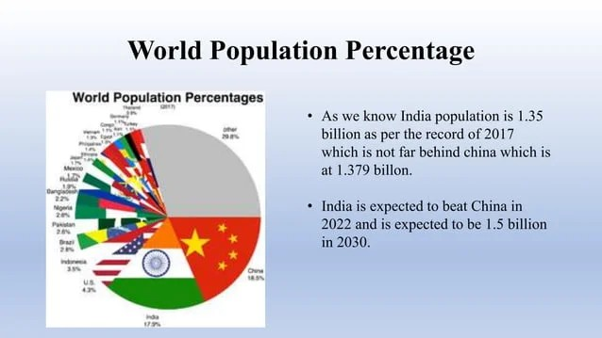

Slide 14
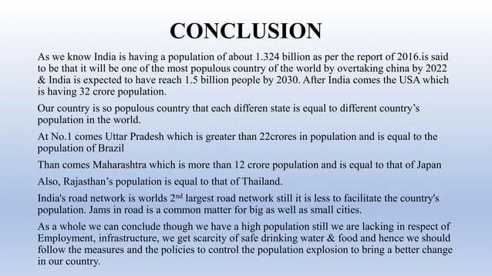

Slide 15


